Slide 1
SQL Server to Azure Synapse Migration Accelerators (Migration Process, Modules, Scripts)
AAAP
Analytics & AI Accelerate Program
Gaiye “Gail” Zhou
February 2022

Slide 2
Disclaimer
Theis document was developed in consultation and collaboration with Microsoft Corporation technical architects. Because Microsoft must respond to changing market conditions, this document should not be interpreted as an invitation to contract or a commitment on the part of Microsoft. Microsoft has provided high-level guidance in this document with the understanding that MICROSOFT MAKES NO WARRANTIES, EXPRESS OR IMPLIED, WITH RESPECT TO THE INFORMATION CONTAINED HEREIN. This document is provided “as-is”. Information and views expressed in this document, including URL and other Internet Web site references, may change without notice. Some examples depicted herein are provided for illustration only and are fictitious. No real association or connection is intended or should be inferred. This document does not provide you with any legal rights to any intellectual property in any Microsoft product. You may copy and use this document for your internal, reference purposes.
© 2021 Microsoft. All rights reserved.

Slide 3


SqlToSynapse Migration Accelerators
Overview – What it does and how it is related to Azure Synapse Pathway
Step 1: Table DDLs Migration – Translate Table DDLs and Execute them in Azure Synapse
Step 1A & 1B: MAP Databases and Schemas from SQL Server to Azure Synapse (for Views, Stored Procedures, and Functions)
Step 2 or 2B: Export SQL Server Data / Step 2A Generate Polybase Export Scripts
Step 3: Upload Data into Azure Storage / Step 3A Execute Polybase Export Scripts to Export SQL Server Tables Data directly into Azure Storage
Step 4: Generate Copy (Into) T-SQL Import Scripts
Step 5: Import Data into Azure Synapse SQL Pool (Execute Code generated in Step 4)

Slide 4

SqlToSynapse Migration Accelerator (PowerShell Scripts)
What does the Scripts do?
Translate SQL Server Table DDLs into Azure Synapse DDLs (Create Table Statements) and execute Table DDLs in Azure Synapse
Export SQL Server tables to .csv or .parquet files
Upload .csv or .parquet files into Azure Storage
Extract SQL Server Code (Views, Stored Procedures and Functions) and perform database and schema mapping
Generate Polybase Export T-SQL Scripts.
Execute Polybase Export T-SQL Scripts – Export data directly into Azure Storage from SQL Server
Generate T-SQL Copy Into Import Scripts.
Execute T-SQL Copy Into Scripts - Import Data into Azure Synapse from Azure Storage.
Where are the scripts and documentation?
AzureSynapseScriptsAndAccelerators/Migration/SQLServer at main · microsoft/AzureSynapseScriptsAndAccelerators (github.com)

Slide 5

Complementary to Azure Synapse Pathway
Why do we need these Scripts when we already have Azure Synapse Pathway?
These Scripts are complementary to Azure Synapse Pathway (ASP). ASP does not perform data migration today. We designed and implemented Powershell modules to complete the end-to-end tasks of tables and data migration (using BCP or Polybase Export).
We recommend using Azure Synapse Pathway for additional Code Translation Tasks or convert code manually when necessary.
You can use scripts described in this document (Module 5_RunSqlFilesInFolder) to execute all translated code by ASP or other methods. Please check the latest release of Azure Synapse Pathway so you can use the best code translation capabilities: sql-docs/azure-synapse-pathway-overview.md at live · MicrosoftDocs/sql-docs (github.com)
In addition, Module 3, 4, 5 are reusable for other types of migrations, for example, Netezza or Teradata or Exadata or Oracle to Azure Synapse migrations. After the code is translated, and data is exported out of source systems, the rest of the tasks are the same. Therefore module 3-5 can be utilized for any of those migrations.

Slide 6
What Do I need to Use the Utilities?
Choose One of the Environments:
Windows PowerShell ISE (preferred)
Visual Studio Code (with PowerShell Extension Installed)
PowerShell Modules required:
(1) Install-Module (Import-module) -name SqlServer
(2) Install-Module (Import-module) -name ImportExcel
(3) Install-Module (Import-module) -Name Az –AllowClobber
PowerShell Permissions (Permissions may be denied if the Scripts are from GitHub or Email):
Use one of the options to set Powershell permissions (examples):
Set-ExecutionPolicy Unrestricted -Scope CurrentUser
Unblock-File -Path C:\migratemaster\modules\1_TranslateTableDDLs\TranslateTables.ps1
Download and Install AzCopy (Only if you will be using BCP Export Method). This task can be skipped if you will be using other methods to upload data into Azure Storge such as Azure Data Box Gateway or Azure Data Explore).
Copy or move data to Azure Storage by using AzCopy v10 | Microsoft Docs

Slide 7
Local .csv/.parquet files or Polybase Export Path
# Step | Export Tables into local .csv or .parquet format | Polybase Export | Results
1 – Task 1 | Translate SQL Tables (Module 1_TranslateTableDDLs) | ← Same | Azure Synapse Table DDLs generated
1 – Task 2 | Execute Synapse Tables DDLs (or DMLs) (Module 5_RunSqlFilesInfolder) | ← Same | Tables Created in Azure Synapse
1 – Task 3 | Extract SQL Server Code and Map Databases and Schemas (Module 1A_ExtractCodeDDLs, and Module 1B_MapDatabasesAndSchemas) | ← Same | Code (Views, Stored Procedures, Functions) have the desired Azure Synapse DB name and Schema Name
1 – Task 4 | Perform Additional Code Translation (Manually or using Azure Synapse Pathway) and then Execute Code using (Module 5_RunSqlFilesInfolder) | ← Same | Code is migrated into Azure Synapse
2 or 2B | Export SQL Server Table data into .csv files (Module 2_ExportSourceDataWithBCP) Export SQL Server Table data into .parquet files (Module 2B_ExportSourceDataToParquet) |  | Data is exported to local files (.csv or .parquet)
2A – Generate Polybase Code |  | Generate Polybase Export Scripts (Module 2A_GeneratePolybaseExportScripts) | Polybase Export T-SQL Scripts generated
3 | Upload exported Data into Azure Storage (Module 3_LoadDataIntoAzureStorage) |  | Data loaded to Azure Storage
3A – Run Polybase Code |  | Execute Polybase Export Scripts (Module 5_RunSqlFilesInfolder) | Data exported directly to Azure Storage from SQL Server
4 | Generate COPY Into Scripts (Module 4_GenerateCopyIntoScripts) | Same as BCP | Copy Into T-SQL Scripts generated
5 | Execute COPY Into Scripts (Module 5_RunSqlFilesInFolder) | Same as BCP | Data imported to Synapse

Slide 8
PowerShell Modules for Exporting into Local files
There are five modules that contain PowerShell Scripts and T-SQL Scripts designed to accomplish key task(s) if you will use BCP Export method.
The modules are summarized as below:
1_TranslateTableDDLs: Translate SQL objects (DDLs) from source system format to Azure Synapse format. The output is stored as .sql files in specified output file folder (configurable). ).
1A_ExtractCodeDDLs: Script out SQL Objects (Views, Functions, Stored Procedures, and Triggers) and write each object into a separate .sql file.
1B_MapDatabasesAndScheams: Map SQL Server Database & Schema into Synapse Database and Schema. In addition, unsupported data types in the code are mostly discovered and counted.
2_ExportSourceDataWithBCP: Export SQL Server Tables into data files stored in predefined structure and format (.csv or .txt)
2B_ExportSourceDataWithBCP: Export SQL Server Tables into data files stored in parquet format (.parquet)
3_LoadDataIntoAzureStorage: Load exported data files into specified container in Azure Storage.
4_GenerateCopyIntoScripts: Generate “COPY Into” T-SQL Scripts that will move data from Azure Storage into Azure Synapse SQL Pool tables, once executed.
5_RunSqlFilesInFolder: Run all T-SQL Scripts defined in .sql files stored in a specified file folder. The T-SQL Scripts can be DDL, DML, Data Movement Scripts (such as Copy Into scripts or Polybase Export Scripts), or any other scripts such as create/update statistics or indexes. In fact, this module is designed to run all T-SQL scripts in a folder (against Azure Synapse or SQL Server).
Note: 5_RunSqlFilesInFolder is reused twice in the process: (1) Run T-SQL Scripts generated from 1_TranslateMetadata, and (2) Run T-SQL Scripts generated from 4_GenerateCopyIntoScripts. You can use module 5_RunSqlFileInFolder to execute code manually translated, mapped by module 1B or translated by Azure Synapse Pathway.
Increase scale by establishing partnerships and collaboration with GBB, CSU, SIs, etc.
Notes:
External (take out the 4th bullet point for the external deck under Charter)

Slide 9
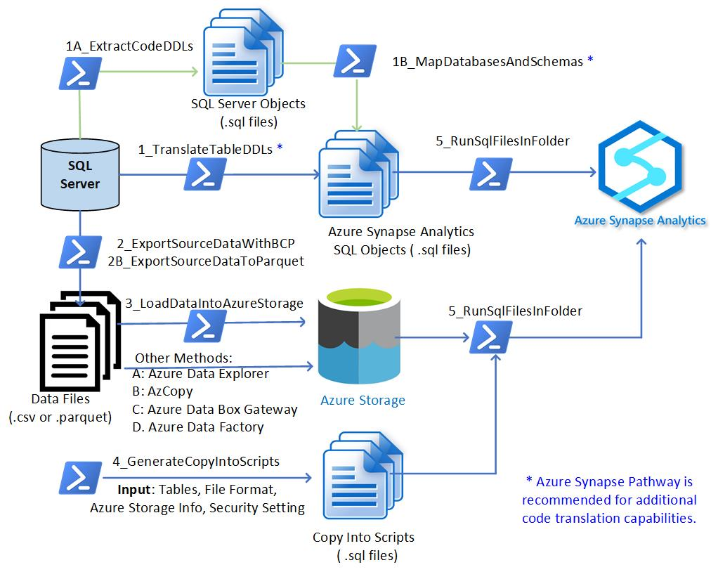
Export SQL Server data into local .csv or .parquet files – All Versions of SQL Servers
Increase scale by establishing partnerships and collaboration with GBB, CSU, SIs, etc.
Notes:
External (take out the 4th bullet point for the external deck under Charter)

Slide 10
PowerShell Modules to Use for Polybase Export
There are four modules that contain PowerShell Scripts and T-SQL Scripts designed to accomplish key task(s) if you will use Polybase Export method.
The modules are summarized as below:
1_TranslateTableDDLs: Translate SQL objects (DDLs) from source system format to Azure Synapse format. The output is stored as .sql files in specified file folder (configurable).
1A_ExtractCodeDDLs: Script out SQL Objects (Views, Functions, Stored Procedures, and Triggers) and write each object into a separate .sql file.
1B_MapDatabasesAndScheams: Map SQL Server Database & Schema into Synapse Database and Schema. In addition, unsupported data types in the code are mostly discovered and counted.
2A_GeneratePolybaseExportScripts: Generate Polybase Export T-SQL Script for each table. Polybase export set up examples are provided in subfolder “Utilities” inside this module.
4_GenerateCopyIntoScripts: Generate “COPY Into” T-SQL Scripts that will move data from Azure Storage into Azure Synapse SQL Pool tables, once executed.
5_RunSqlFilesInFolder: Run all T-SQL Scripts defined in .sql files stored in a specified file folder. The T-SQL Scripts can be DDL, DML, Data Movement Scripts (such as Copy Into scripts or Polybase Export Scripts), or any other scripts such as create/update statistics or indexes. In fact, this module is designed to run all T-SQL scripts in a folder (against Azure Synapse or SQL Server).
Note: 5_RunSqlFilesInFolder is reused three times in the process: (1) Run T-SQL Scripts generated from 1_TranslateMetadata, (2) Run T-SQL Scripts generated from 2A_GeneratePolybaseExportScripts, and (3) Run T-SQL Scripts generated from 4_GenerateCopyIntoScripts. You can use module 5_RunSqlFileInFolder to execute code manually translated, mapped by module 1B or translated by Azure Synapse Pathway.
Increase scale by establishing partnerships and collaboration with GBB, CSU, SIs, etc.
Notes:
External (take out the 4th bullet point for the external deck under Charter)

Slide 11
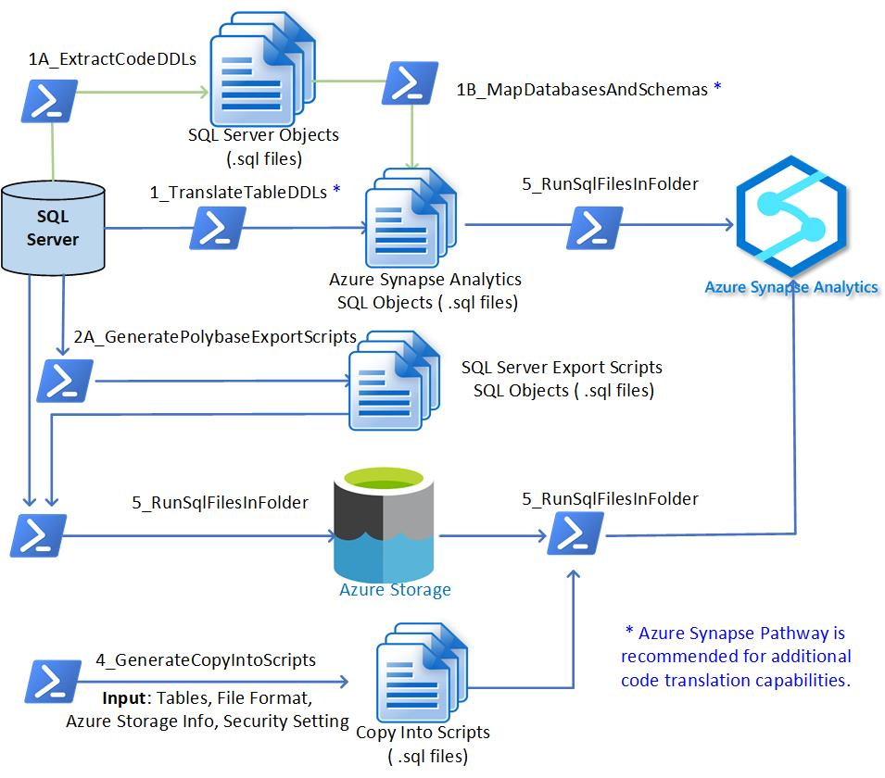
SQL Server to Synapse Migration Tasks Carried out by PowerShell Scripts (Modules) – Polybase Export – SQL Servers 2016+
Increase scale by establishing partnerships and collaboration with GBB, CSU, SIs, etc.
Notes:
External (take out the 4th bullet point for the external deck under Charter)

Slide 12
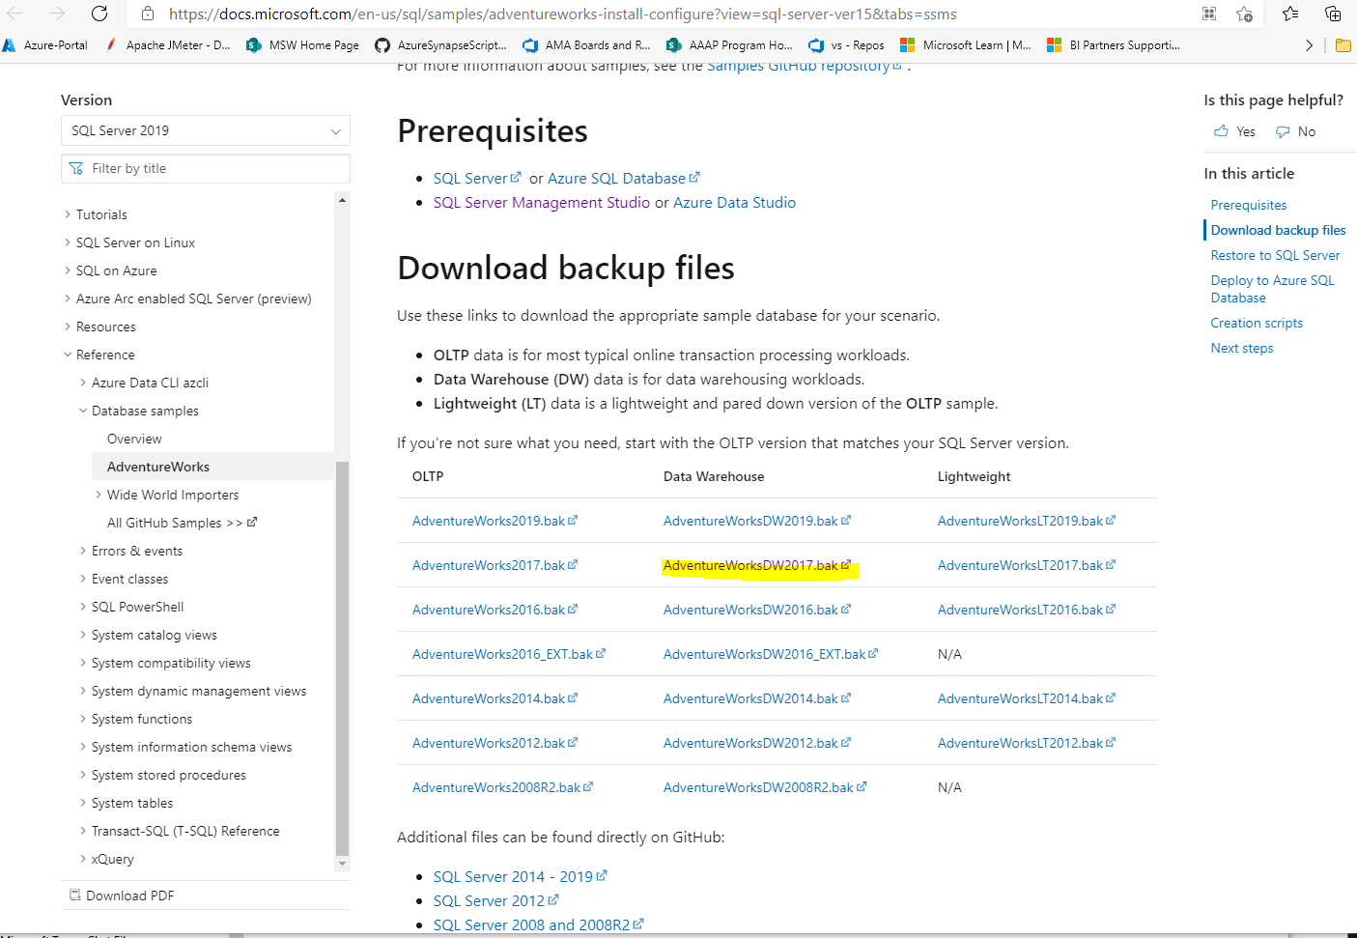
To Test the Scripts with an actual SQL Server & Azure Synapse
(1) Set up your Azure Synapse Workspace with Azure SQL Pool Created
(2) Download AdventureWorksDW2017.bak from the link below and restore it to your SQL Server.
AdventureWorks sample databases - SQL Server | Microsoft Docs
How to Restore SQL Server Database to .bak file
Restore a Database Backup Using SSMS - SQL Server | Microsoft Docs
Download SQL Server 2017 if you do not have a SQL Server already
https://www.microsoft.com/en-us/sql-server/sql-server-2017
Download SSMS if you don’t have it already
Download SQL Server Management Studio (SSMS) - SQL Server Management Studio (SSMS) | Microsoft Docs

Slide 13
5-Step Migration Process with BCP Export - You can use this method for all versions of SQL Servers If you have SQL Server 2016 or later, you have additional option to export SQL server data directly into Azure Storage. See details later in this presentation. (Polybase is available only for SQL Server 2016 or later)

Slide 14
Export SQL Server Tables into Local .csv or .parquet
# Step | BCP Export | Results
1 – Task 1 | Translate SQL Tables (Module 1_TranslateTableDDLs) | Azure Synapse Table DDLs generated
1 – Task 2 | Execute Synapse Tables DDLs (Module 5_RunSqlFilesInfolder) | Tables Created in Azure Synapse.
1 – Task 3 | Map Databases and Schemas (Module 1A_ExtractCodeDDLs, and Module 1B_MapDatabasesAndSchemas) | Code (Views, Stored Procedures, Functions) have the desired Azure Synapse DB name and Schema Name
1 – Task 4 | Perform Additional Code Translation (Manually or using Azure Synapse Pathway) and then Execute Code using (Module 5_RunSqlFilesInfolder) | Code is migrated into Azure Synapse
2 – Export to .csv 2B – Export to .parquet | Export SQL Server Table data into .csv files (Module 2_ExportSourceDataWithBCP) Export SQL Server Table data into .parquet files (Module 2B_ExportSourceDataToParquet) | Data is exported to local files (.csv or .parquet)
3 – Upload | Upload exported Data into Azure Storage (3_LoadDataIntoAzureStorage) | Data loaded to Azure Storage
4 | Generate COPY Into Scripts (Module 4_GenerateCopyIntoScripts) | Copy Into T-SQL Scripts generated
5 | Execute COPY Into Scripts (Module 5_RunSqlFilesInFolder) | Data imported to Synapse

Slide 15
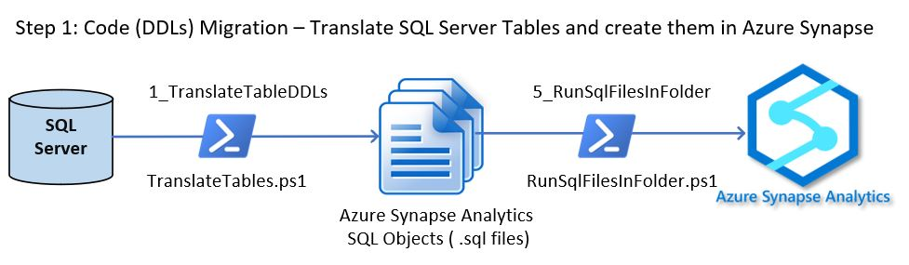
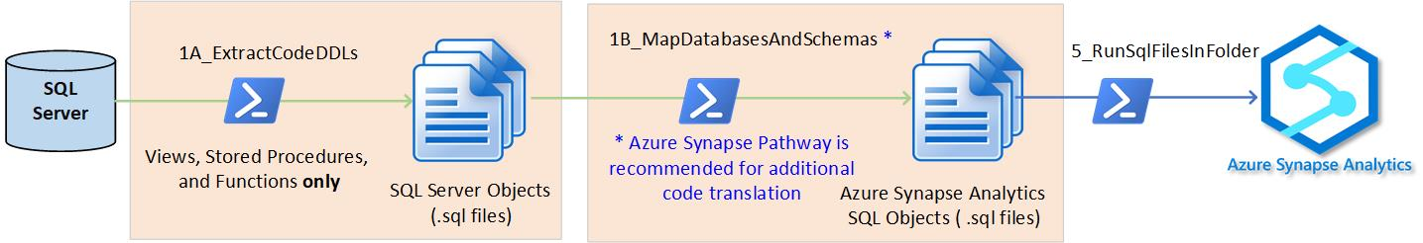
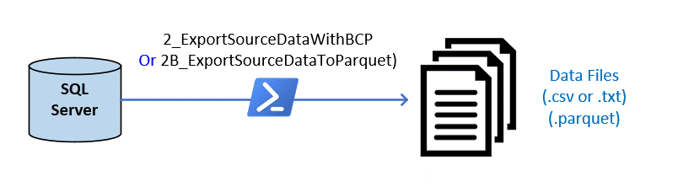
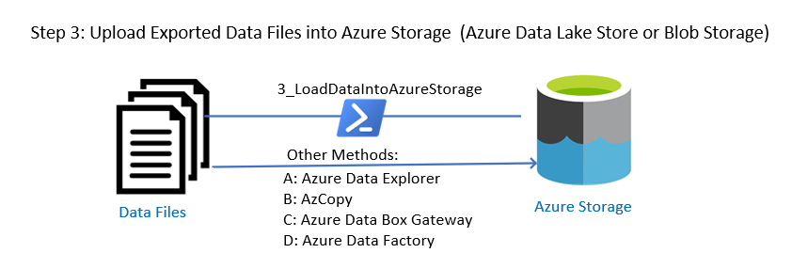
Step 1
(Same for BCP and Polybase Export)
Step 1AB
Step 2 or 2B
Step 3

Slide 16
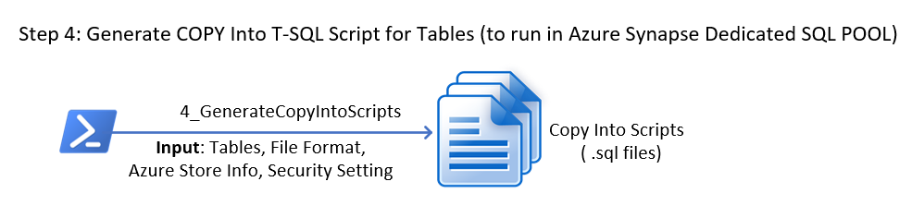
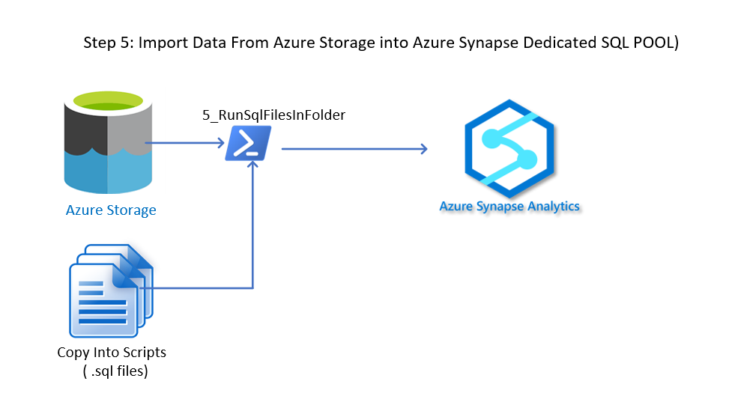
Note: Step 4 and Step 5 are the same for BCP or Polybase Export
Step 4
Step 5

Slide 17
5-Step Migration Process with Polybase Export (Polybase is available only for SQL Server 2016 or later)

Slide 18
Polybase Export Path
# Step | Polybase Export | Results
1 – Task 1 | Translate SQL Tables (Module 1_TranslateTableDDLs) | Azure Synapse Table DDLs generated
1 – Task 2 | Execute Synapse Tables DDLs (Module 5_RunSqlFilesInfolder) | Tables Created in Azure Synapse.
1 – Task 3 | Map Databases and Schemas (Module 1A_ExtractCodeDDLs, and Module 1B_MapDatabasesAndSchemas) | Code (Views, Stored Procedures, Functions) have the desired Azure Synapse DB name and Schema Name
1 – Task 4 | Perform Additional Code Translation (Manually or using Azure Synapse Pathway) and then Execute Code using (Module 5_RunSqlFilesInfolder) | Code is migrated into Azure Synapse
2A – Generate Polybase Code | Generate Polybase Export Scripts (Module 2A_GeneratePolybaseExportScripts) | Polybase Export T-SQL Scripts generated
3A – Run Polybase Code | Execute Polybase Export Scripts (Module 5_RunSqlFilesInfolder) | Data exported directly to Azure Storage from SQL Server
4 | Generate COPY Into Scripts (Module 4_GenerateCopyIntoScripts) | Copy Into T-SQL Scripts generated
5 | Execute COPY Into Scripts (Module 5_RunSqlFilesInFolder) | Data imported to Synapse

Slide 19
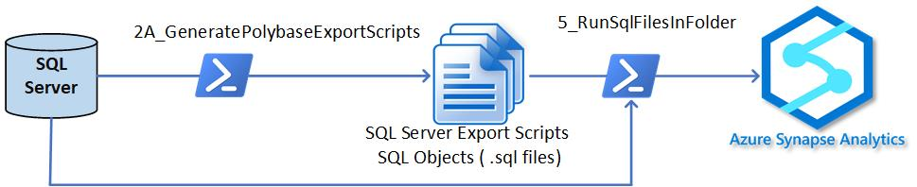
Step 1
(Same for BCP and Polybase Export)
Step 1AB
Step 2A & 3A

Slide 20
Note: Step 4 and Step 5 are the same for BCP or Polybase Export
Step 4
Step 5

Slide 21
Thank you

